Slide 1

YouTube Video Summarizer
by
Ganne Sreeja
224G1A33A9
Department of Computer Science and Engineering (AI&ML)
Srinivasa Ramanujan Institute of Technology
Autonomous
Rotarypuram Village, B K Samudram Mandal, Ananthapuramu – 515701.
2024-2025

Slide 2
Contents:
Abstract
Problem Statement
Model
Objectives
Use Cases

Slide 3
Abstract:
Youtube summarizer will summarize the content of the video by keeping all the important points and making it short and easily understandable. Summarizing transcripts of such videos automatically allows us to quickly look out for the important patterns in the video and helps us to save time and efforts to go through the whole content of the video.
This Project is a Python application that allows you to summarize the content of a YouTube video using OpenAI's GPT-3.5 language model and Langchain. The application get the transcription provided by YouTube, chunks the Transcription with Langchain and generates a summary in the language of the youtube video.

Slide 4
Problem Statement:
With the vast amount of content on YouTube, users often find it difficult to consume lengthy videos efficiently. Manually watching videos to extract key information is time-consuming, especially for educational or informational content. There is a need for an automated solution that summarizes YouTube videos, providing viewers with concise, relevant summaries without watching the entire video.
The solution is YouTube Summarizer project aims to develop an intelligent system that automatically generates concise summaries of YouTube videos, capturing the essential information while reducing the time required for consumption.

Slide 5
Model
This Project is a Python application that allows you to summarize the content of a YouTube video using OpenAI's GPT-3.5 language model and Langchain. The application get the transcription provided by YouTube, chunks the Transcription with Langchain and generates a summary in the language of the youtube video.
Features
Get the Transcription from Youtube
Chunks the transcriptions with Langchain
Summarizes transcribed text using OpenAI's GPT-3.5 model
Built with Streamlit for an easy-to-use web interface

Slide 6
Objectives
Efficient Content Consumption:Summarize lengthy YouTube videos to save users time by offering key insights or highlights, making it easier to digest long content quickly. Improved Accessibility: Provide text-based summaries for users who prefer reading over watching videos, or for those with hearing impairments, ensuring content is more accessible.
Contextual Understanding: Generate summaries that retain the main context and message of the video while omitting unnecessary details, maintaining the integrity of the original content.
Multi-Language Support: Offer summaries in multiple languages to cater to global audiences and make videos understandable to non-native speakers of the video’s original language.

Slide 7
Use Cases:
Time-Saving for Viewers: Viewers can quickly understand the main points of a long video without watching the entire content, especially useful for tutorials, educational videos, and interviews.
Assistance for Researchers and Students: Researchers or students can use summaries to quickly review educational or documentary content, helping them gather information faster for studies, projects, or exams.
Supporting Language Learning: Summarizing videos can assist language learners by providing concise overviews, making it easier for them to understand the content without being overwhelmed by the full transcript.
Content Archiving and Review: Video creators and marketers can use summaries for archiving content, enabling a quick review of past videos and identifying key highlights for repurposing in future content strategies.
Boost Productivity: Professionals can consume summaries of informational or training videos to stay informed and productive without dedicating significant time to watching the entire content.
 | ReplyForward

Slide 8
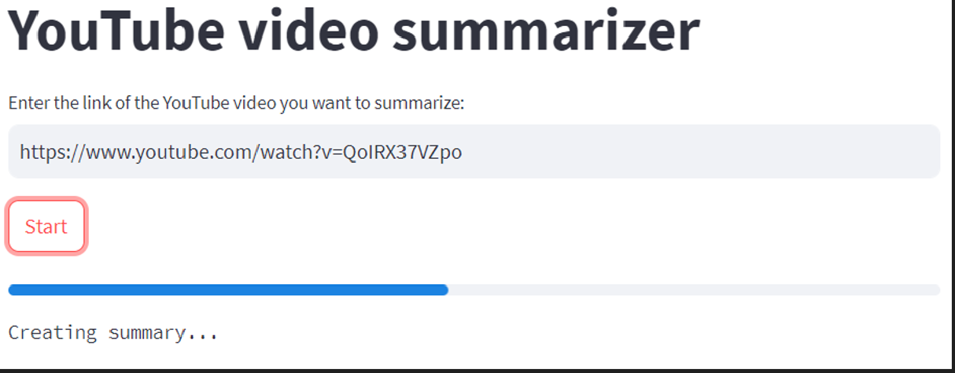

Slide 9
Any Queries?

Slide 10
Thank you!!

